Slide 1
Excel Pivot Tables
By Martha Nelson
Digital Learning Specialist

Slide 2
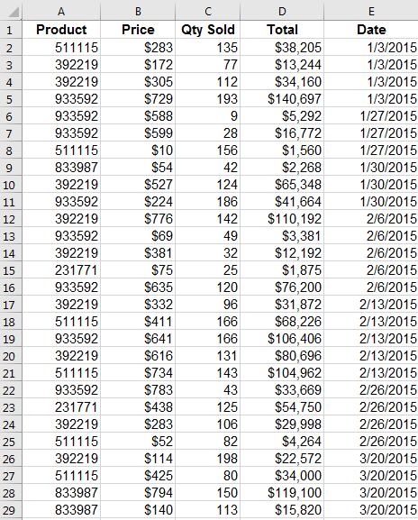
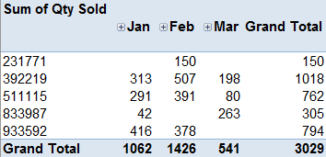
PivotTables summarize and analyze large amounts of data into summary reports.
Notes:
PivotTables allow you to quickly summarize and analyze large amounts of data in lists and tables--independent of the original data layout in your spreadsheet--by dragging and dropping columns to different rows, columns, or summary positions

Slide 3
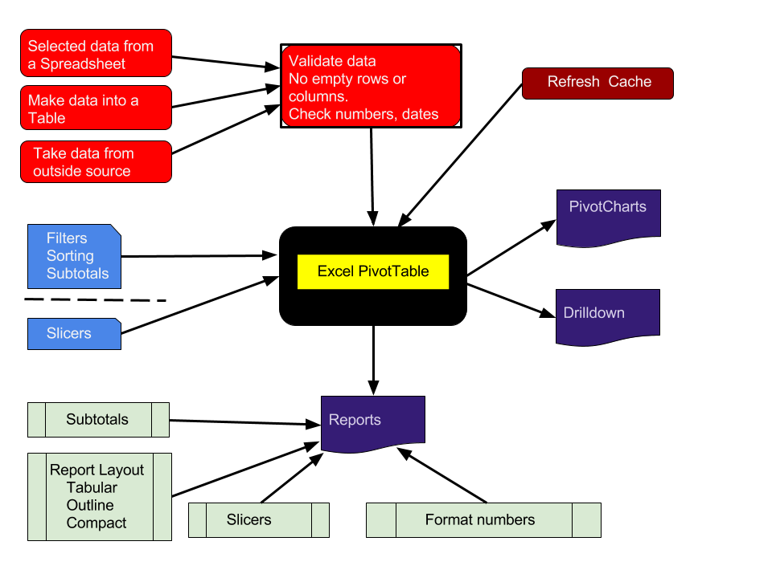
Parts of a PivotTable
Notes:
Parts of a Pivot Table
These are the major components of a PivotTable. At minimum, one needs only one of the red boxes in the upper left, the black box of the actual PivotTable, and one of the Purple boxes.

Slide 4
1) Let’s create our first Pivot table.
Open file “PivotTableClass”
Click on Sales tab
Select all cells, including header row.
Insert tab > PivotTable (most left side)
Click “OK” on pop-up window
Automatically directed to new sheet, with PivotTable controls.
Notes:
Parts of a Pivot Table

Slide 5
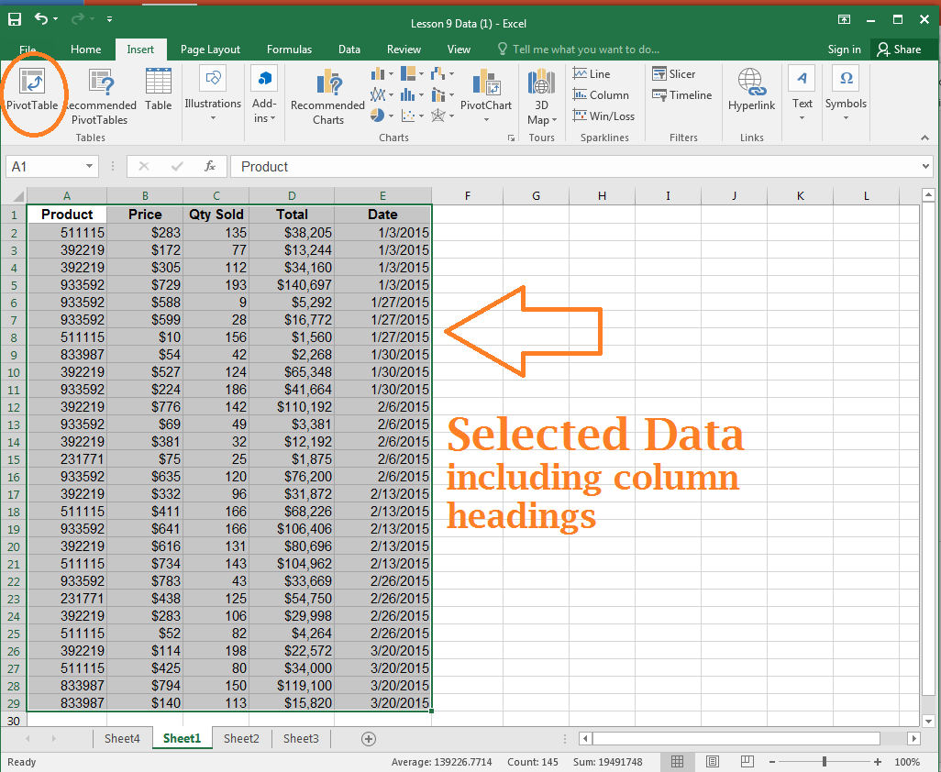
Notes:
Parts of a Pivot Table

Slide 6
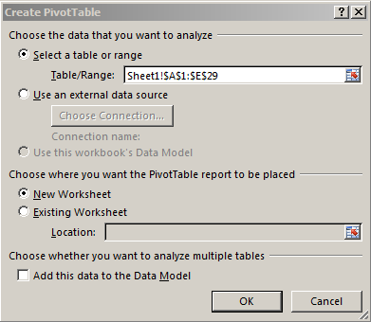
The Create PivotTable Dialog box.
The address of the data we just selected appears here.
Most frequently we put the new PivotTable on an new worksheet.
Click OK
Notes:
If we wanted to use an external data source, we’d check the 2nd radio button.

Slide 7
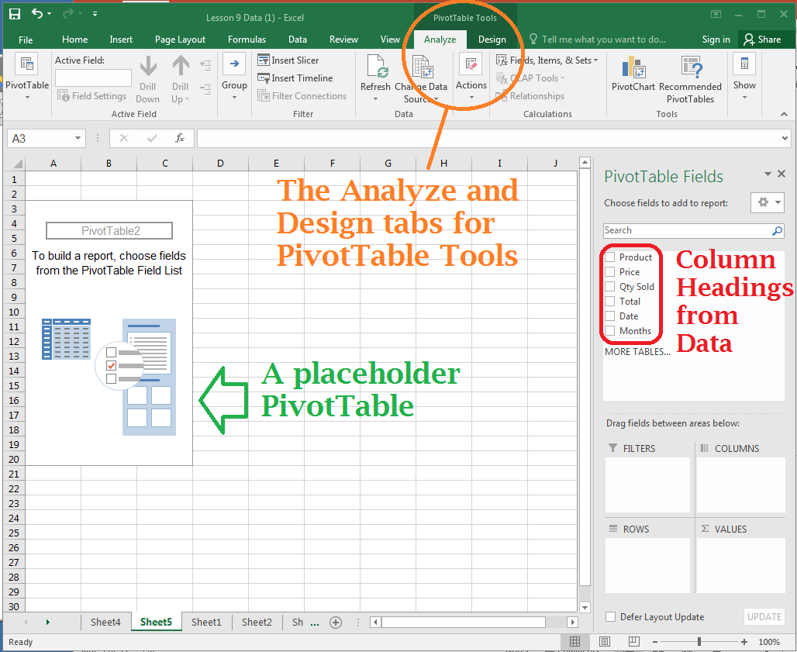
Notes:
Parts of a Pivot Table
Notice when you click on the table, or placeholder table, you get the PivotTable Tools tab in the Ribbon.

Slide 8
The ribbon for PivotTables
Notes:
Parts of a Pivot Table
Notice when you click on the table, or placeholder table, you get the PivotTable Tools tab in the Ribbon.

Slide 9
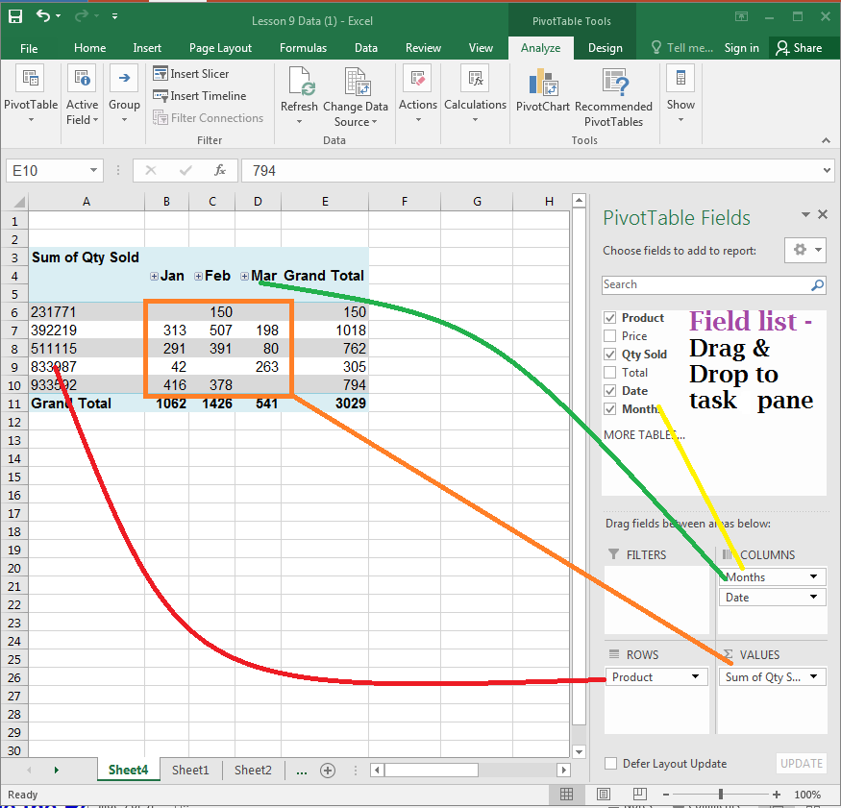
Parts of a PivotTable
Excel 2016
Notes:
Parts of a Pivot Table

Slide 10
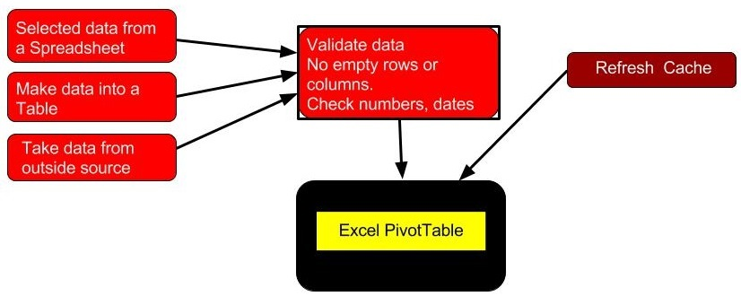
A closer view:
Input to a PivotTable
Notes:
Input to a PivotTable
For this class, we will not cover “Take Data from an outside source”.

Slide 11
2) Data
Select data from a spreadsheet
A Table
External Data (not covered in this class)
Notes:
How to create a Table:
https://support.office.com/en-us/article/Quick-start-Create-an-Excel-table-33d08e18-fa0f-40fe-8af3-5683b034ec42
Tables provide easy filtering, in addition to calculated columns and total rows, which make calculations simple.
On a worksheet, select the range of cells that you want to include in the table. The cells can be empty or can contain data.
On the Home tab, in the Styles group, click Format as Table, and then click the table style that you want.
Benefits of using a Table over selecting data:
If you add rows to a table, the next time

Slide 12
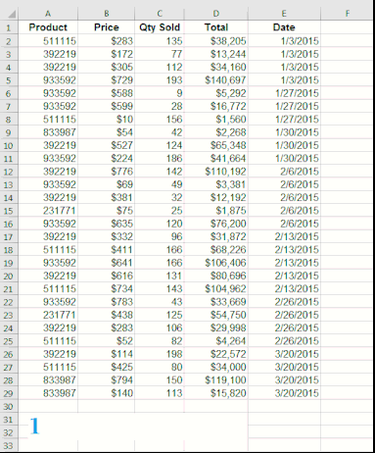
Select data from a spreadsheet
Click on upper left part of data, including the column heading.
Press Shift key.
Click on lower right cell of data.
Release Shift key.
Notes:
How to create a Table:
https://support.office.com/en-us/article/Quick-start-Create-an-Excel-table-33d08e18-fa0f-40fe-8af3-5683b034ec42
Tables provide easy filtering, in addition to calculated columns and total rows, which make calculations simple.
On a worksheet, select the range of cells that you want to include in the table. The cells can be empty or can contain data.
On the Home tab, in the Styles group, click Format as Table, and then click the table style that you want.
Benefits of using a Table over selecting data:
If you add rows to a table, the next time

Slide 13
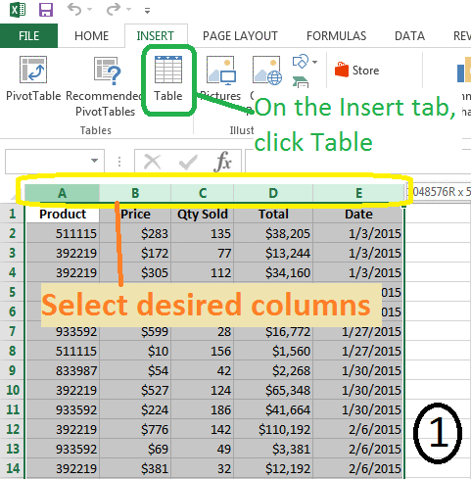
Create a table from data
Select all the desired cells
Insert tab > Table
Click “OK” on the Create Table dialog box.
Note the Name Box – it now has Table1 in it.
Notes:
How to create a Table:
https://support.office.com/en-us/article/Quick-start-Create-an-Excel-table-33d08e18-fa0f-40fe-8af3-5683b034ec42
Tables provide easy filtering, in addition to calculated columns and total rows, which make calculations simple.
On a worksheet, select the range of cells that you want to include in the table. The cells can be empty or can contain data.
On the Home tab, in the Styles group, click Format as Table, and then click the table style that you want.
Benefits of using a Table over selecting data:
If you add rows to a table, the next time

Slide 14
When you create a PivotTable, a copy of the data is stored in a pivot cache. Any changes to the data won’t show up in the report until you refresh the cache.
To refresh the data:
Right-click the pivot table and click Refresh Data. Or
Go to the Options tab, and click the Refresh button
Notes:
Cache (definition):
To store data locally in order to speed up subsequent retrievals. Pronounced "cash."
Reserved areas of memory in every computer that are used to speed up instruction execution, data retrieval and data updating.
File limits:
Open workbooks Limited by available memory and system resources
Worksheet size 1,048,576 rows by 16,384 columns
Pivot Tables Behind the Scenes
It’s important to know that pivot tables come with a few file space and memory implications for your system. To get an idea of what this means, let’s look at what happens behind the scenes when you create a pivot table.
When you initiate the creation of a pivot table report, Excel takes a snapshot of your data set and stores it in a pivot cache, which is a special memory subsystem where your data source is duplicated for quick access. Although the pivot cache is not a physical object you can see, you can think of it as a container that stores a snapshot of the data source.
Caution
Any changes you make to your data source are not picked up by your pivot table report until you take another snapshot of the data source or “refresh” the pivotcache. Refreshing is easy: Simply right-click the pivot table and click Refresh Data. You can also click the large Refresh button on the Options tab.
The benefit of working against the pivot cache and not your original data source is optimization. Any changes you make to the pivot table report, such as rearranging fields, adding new fields, or hiding items, are made rapidly and with minimal overhead.

Slide 15
Do Exercises #1a, #1b, and #1c.
Notes:
Cache (definition):
To store data locally in order to speed up subsequent retrievals. Pronounced "cash."
Reserved areas of memory in every computer that are used to speed up instruction execution, data retrieval and data updating.
File limits:
Open workbooks Limited by available memory and system resources
Worksheet size 1,048,576 rows by 16,384 columns
Pivot Tables Behind the Scenes
It’s important to know that pivot tables come with a few file space and memory implications for your system. To get an idea of what this means, let’s look at what happens behind the scenes when you create a pivot table.
When you initiate the creation of a pivot table report, Excel takes a snapshot of your data set and stores it in a pivot cache, which is a special memory subsystem where your data source is duplicated for quick access. Although the pivot cache is not a physical object you can see, you can think of it as a container that stores a snapshot of the data source.
Caution
Any changes you make to your data source are not picked up by your pivot table report until you take another snapshot of the data source or “refresh” the pivotcache. Refreshing is easy: Simply right-click the pivot table and click Refresh Data. You can also click the large Refresh button on the Options tab.
The benefit of working against the pivot cache and not your original data source is optimization. Any changes you make to the pivot table report, such as rearranging fields, adding new fields, or hiding items, are made rapidly and with minimal overhead.

Slide 16
The data needs to be clean.
Any blank rows, blank columns, or text in a number field will give unpredictable results.
Ex: Summing a number field with blanks becomes a Count.
Use Conditional formatting on number fields to search for invalid data.
Notes:
Pivot Tables Behind the Scenes
It’s important to know that pivot tables come with a few file space and memory implications for your system. To get an idea of what this means, let’s look at what happens behind the scenes when you create a pivot table.
When you initiate the creation of a pivot table report, Excel takes a snapshot of your data set and stores it in a pivot cache, which is a special memory subsystem where your data source is duplicated for quick access. Although the pivot cache is not a physical object you can see, you can think of it as a container that stores a snapshot of the data source.
Caution
Any changes you make to your data source are not picked up by your pivot table report until you take another snapshot of the data source or “refresh” the pivotcache. Refreshing is easy: Simply right-click the pivot table and click Refresh Data. You can also click the large Refresh button on the Options tab.
The benefit of working against the pivot cache and not your original data source is optimization. Any changes you make to the pivot table report, such as rearranging fields, adding new fields, or hiding items, are made rapidly and with minimal overhead.

Slide 17
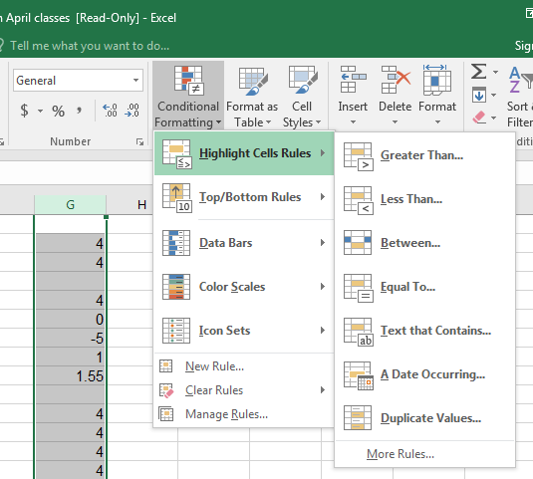
Find invalid numbers
Select a column or range of cells.
Home > Conditional Formatting
Notes:
https://support.office.com/en-us/article/Use-a-formula-to-apply-conditional-formatting-in-Excel-2016-for-Mac-34093090-235b-4476-a7ce-1da7880c750f
Simple example of highlighting errors, using Conditional Formatting:
Select column or range of data
Click on the Home tab, and in the Styles group, click on Conditional Formatting.
Click on “Highlight Cells Rules”, and then “Less Than”, and put in .05 and choose a color.
This will identify blank and negative numbers.
Understanding Why One Blank Cell Causes a Count
If all the cells in a column contain numeric data, Excel chooses to sum. If just one cell is either blank or contains text, Excel chooses to count.
In Figure 3.23, the worksheet contains mostly numeric entries but has a single blank cell in G2. The one blank cell is enough to cause Excel to count the data instead of summing.

Slide 18
The data :
Must have Column Headings in the first row.
Must have tabular layout - no blank rows or columns.
No repeating columns of data
Normalized data
Notes:
Ensuring That Data Is in a Tabular Layout
A perfect layout for the source data in a pivot table is a tabular layout. In tabular layout, there are no blank rows or columns. Every column has a heading. Every field has a value in every row. Columns do not contain repeating groups of data.
Tabular layouts are database centric, meaning you would most commonly find these types of layouts in databases. These layouts are designed to store and maintain large amounts of data in a well-structured, scalable format.
You might work for a manager who demands that the column labels be split into two rows. For example, he might want the heading Gross Margin to be split, with Gross in row 1 and Margin in row 2. Because pivot tables require a unique heading one row high, your manager’s preference can be problematic. To overcome this problem, start typing your heading; for example, type Gross. Before leaving the cell, press Alt+Enter and then type Margin. The result is a single cell that contains two lines of data.

Slide 19
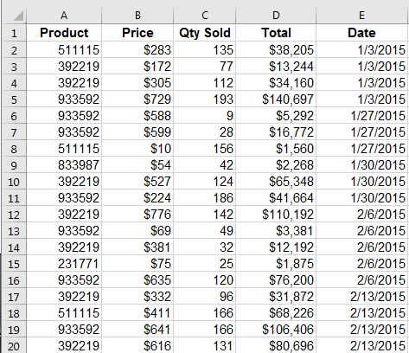
Discuss why this is a good source of data for a PivotTable
Notes:
Ensuring That Data Is in a Tabular Layout
A perfect layout for the source data in a pivot table is a tabular layout. In tabular layout, there are no blank rows or columns. Every column has a heading. Every field has a value in every row. Columns do not contain repeating groups of data.
Tabular layouts are database centric, meaning you would most commonly find these types of layouts in databases. These layouts are designed to store and maintain large amounts of data in a well-structured, scalable format.
You might work for a manager who demands that the column labels be split into two rows. For example, he might want the heading Gross Margin to be split, with Gross in row 1 and Margin in row 2. Because pivot tables require a unique heading one row high, your manager’s preference can be problematic. To overcome this problem, start typing your heading; for example, type Gross. Before leaving the cell, press Alt+Enter and then type Margin. The result is a single cell that contains two lines of data.

Slide 20
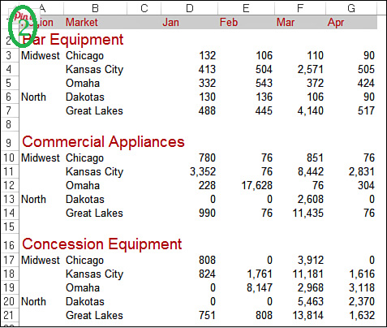
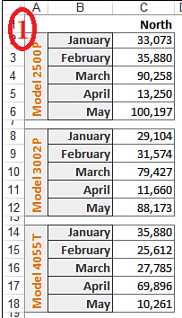
Discuss why these are bad sources of data for a PivotTable
Notes:
All – data is arranged almost like a PivotTable - summed up by month
#1 and #2 have blank rows
#2 – if Equipment category was listed on each line.
#3 has “North” in Col A, but it might work if it said “North” in A3:A8

Slide 21
Let’s do exercises!
Do Exercises #2a and #2b
Notes:
All – data is arranged almost like a PivotTable - summed up by month
#1 and #2 have blank rows
#2 – if Equipment category was listed on each line.
#3 has “North” in Col A, but it might work if it said “North” in A3:A8

Slide 22
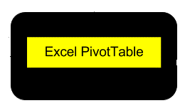
Think of PivotTables as how to solve a word problem: What is the question asking?
Open the BigData tab and review the information.
Can you think of certain questions an analyst would like to see?
Notes:
Who sold the most items?
By region, which products sold the most?
By date, which salesperson sold the most items?
What is the biggest seller by dollar amount?
Which customer uses more than one sales rep?

Slide 23
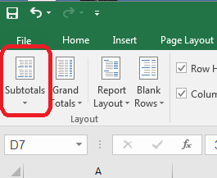
Subtotals
PivotTable Tools > Design >Layout
Subtotals control allows you to toggle subtotals on and off, as well as place them at the top or bottom of the section.

Slide 24
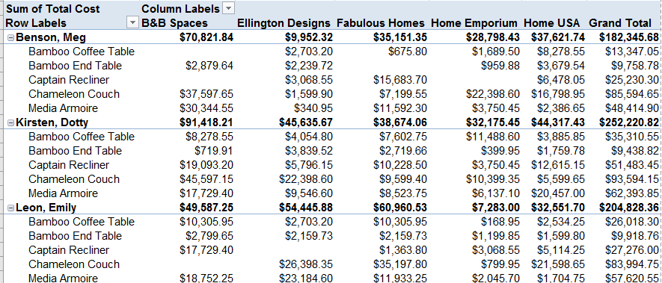
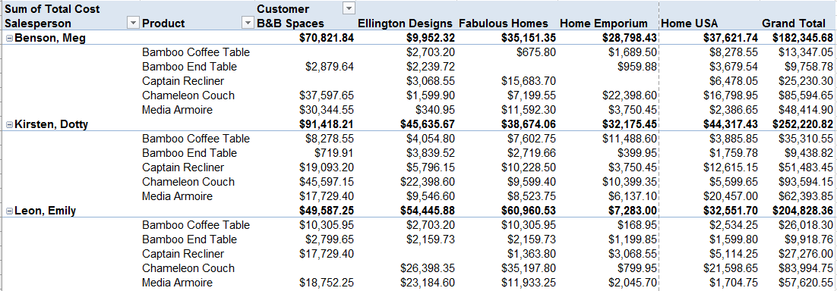
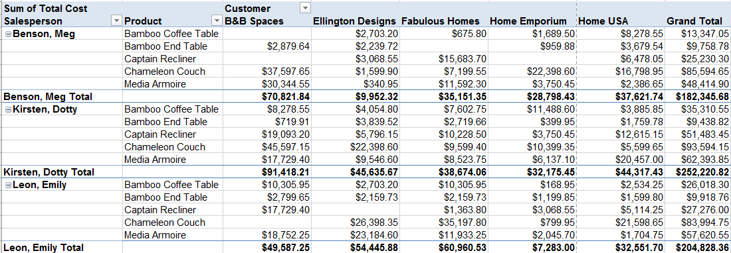
Report options:
Compact
Outline
Tabular
Notes:
Compact form displays items from different row area fields in one column and uses indentation to distinguish between the items from different fields. Row labels take up less space in compact form, which leaves more room for numeric data. Expand and Collapse buttons are displayed so that you can display or hide details in compact form. Compact form is saves space and makes the PivotTable report more readable and is therefore specified as the default layout form for PivotTables.
Tabular form displays one column per field and provides space for field headers.
Outline form is similar to tabular form but it can display subtotals at the top of every group because items in the next column are displayed one row below the current item.

Slide 25
There are at least two ways of selecting / limiting data:
Filters
Slicers
Notes:
Using Excel Pivot Table Top 10 Filters
You can summarize your data by creating an Excel Pivot Table, and then use Value Filters to focus on the top 10, bottom 10 or a specific portion of the total values in your data.
For example, instead of showing the total sales for all products, use a filter to show just the top 10 products, or narrow it down to the top 2.
Using Filters is fast, but if you filter out certain types of data, the report reader has no way of knowing what is being left out.
Slicers give a great visual interface for seeing exactly what is in the data selected.

Slide 26
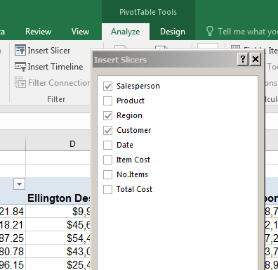
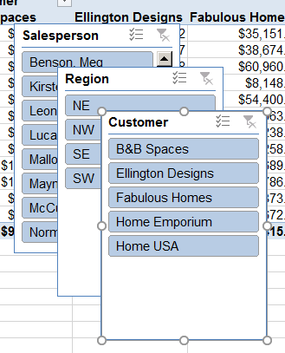
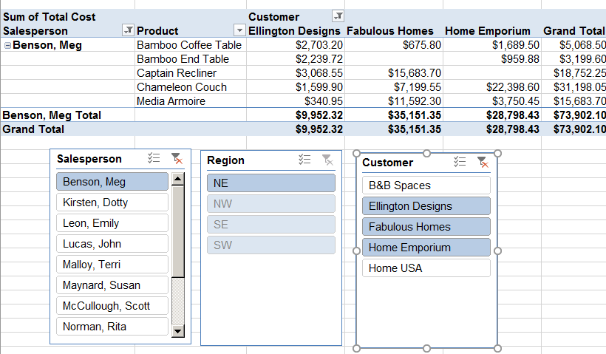
Slicers
Interactive, good for doing “what-if” scenarios

Slide 27
Filters
Click on any of the “Drop down arrows to see the filter options.

Slide 28
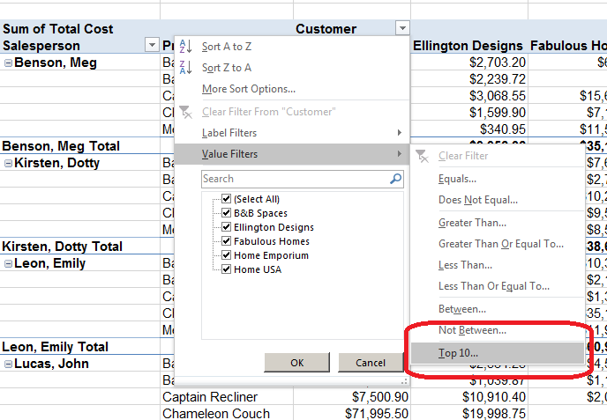
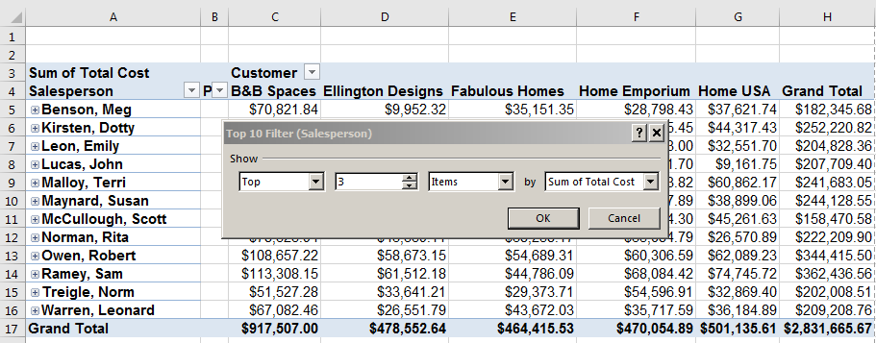
Filters
Value Filters > Top 10

Slide 29
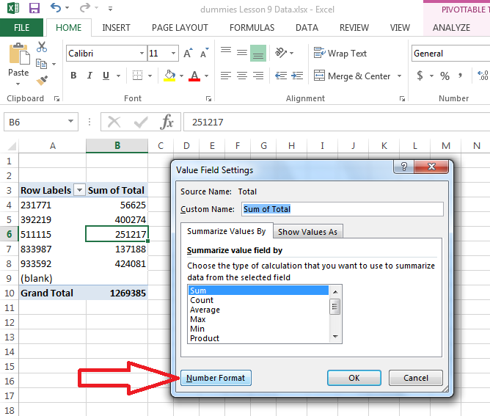
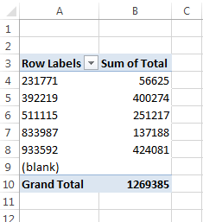
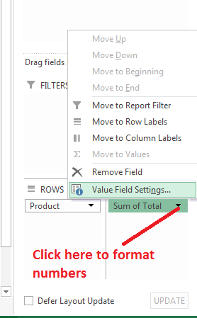
Format Numbers
When you create a PivotTable, Dates and numbers loose their formatting

Slide 30
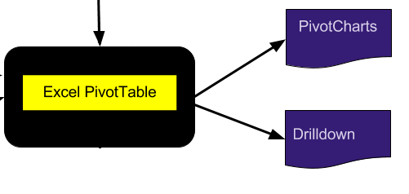
Drill down
double click on a Value Field and Excel will generate a new sheet listing all the components in that field.

Slide 31
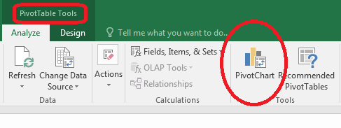
Pivot Charts
PivotTable Tools > Data > Analyze > PivotChart
Follow the wizard through the regular Chart options.

Slide 32
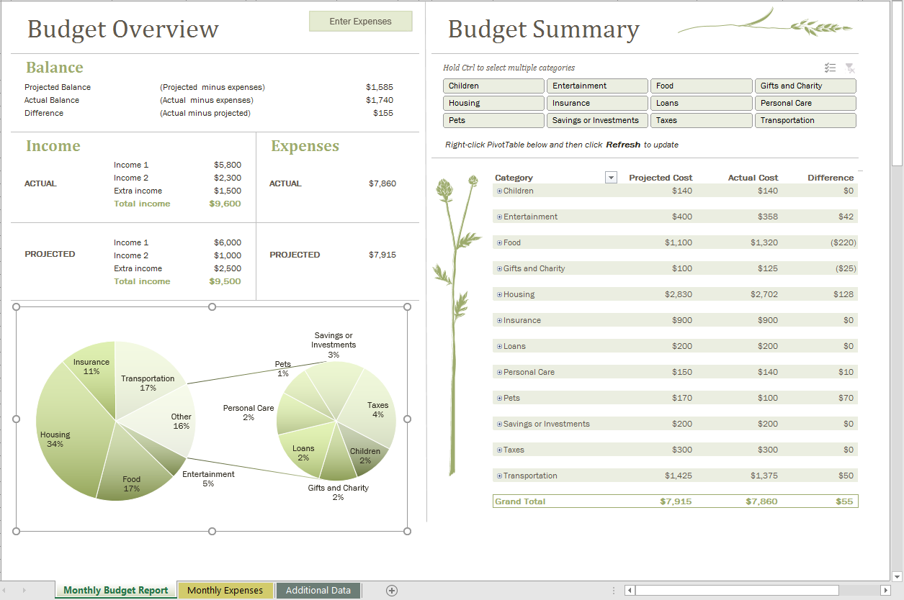
Excel 2016

Slide 33
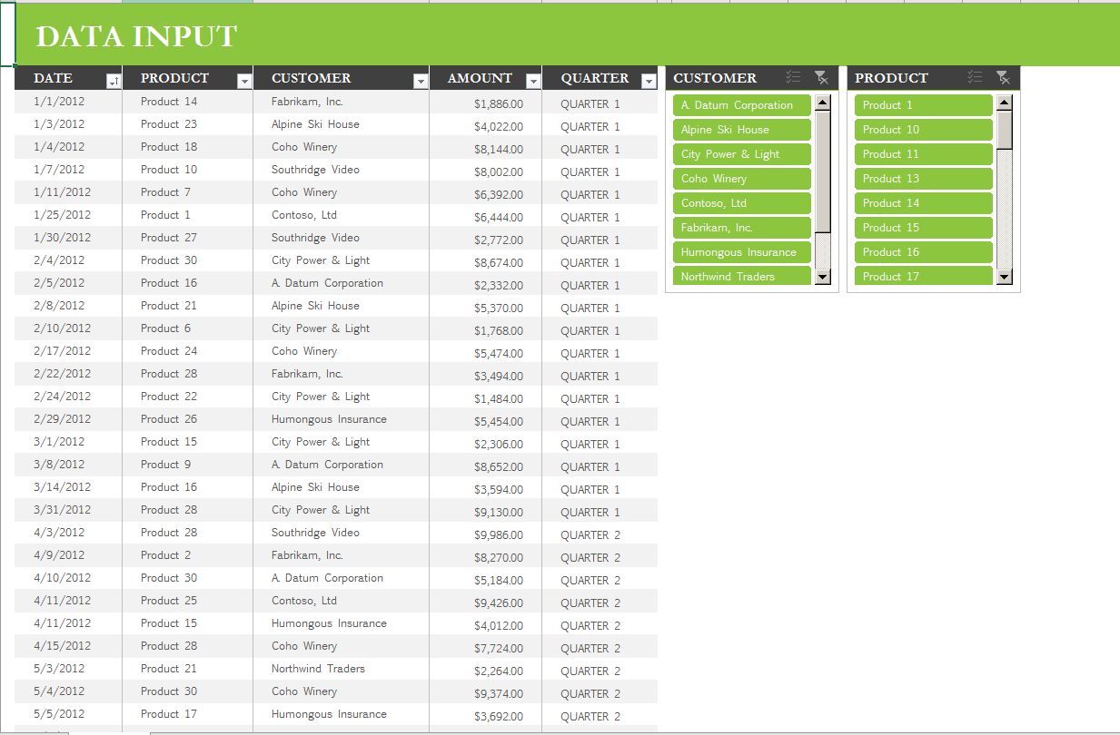
Excel 2016

Slide 34
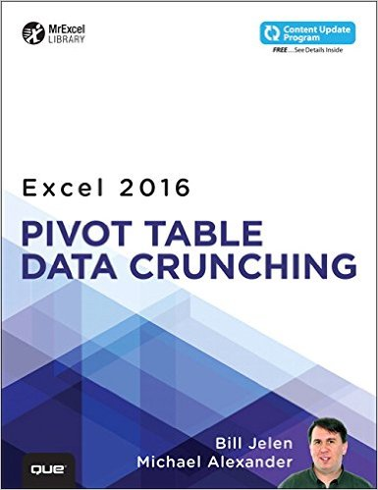
I recommend this book as the best PivotTable reference available. Skokie Library has it available as an electronic book. (EPUB)
Excel 2015 Pivot Table Data Crunching, by Bill Jelen and Michael Alexander
Notes:
Think of a pivot table as a kaleidoscope that is pointed at a data set. When you look at a data set through a pivot table, you have the opportunity to see details in the data that you might not have noticed before. Furthermore, you can turn your pivot table to see your data from different perspectives. The data set itself doesn’t change, and it’s not connected to the pivot table. The pivot table is simply a tool you use to create a unique perspective on your data.

Slide 35
More Excel classes:
Charts and Graphs
Formulas and Functions
Making a Budget using Excel
Notes:
This is an extremely high level view, there is an entire class on formulas and functions, as well as many books that will give more detail
Many people use the two terms interchangeably, and both do math.
A function is a built-in operation, such as SUM(), AVERAGE() etc. Functions are always capitalized. What you need to put between the parentheses is called the argument, and it must be the right type of data, etc. For example, you wouldn’t want to sum a date, you’d want to sum a number.
A formula starts with an = sign. Ex: =(D1+D2) or =(2+4)
A formula can use functions. Ex: =AVERAGE(A1:A40)
To do math in a formula, use these operators: (, ), -, +, * / or: parenthesis, minus, plus, multiplication, and divide

Slide 36
Thank You
Want a copy of this presentation?
Visit www.skokielibrary.info/handouts
where this presentation will be available
for four weeks.

