Slide 1
Excel Create a Budget
By Martha Nelson
Digital Learning Specialist

Slide 2
I got my mind on my money
And my money on my mind.
- Snoop Dogg, 1994

Slide 3
I am neither a Certified Public Accountant, nor a Financial Advisor.
This is a conversation. Please talk to your neighbor or me.
Sometimes I make a mistake – please let me know before we all get confused.
Sometimes computers make mistakes or behave weird.

Slide 4
What is a budget?
An estimation of the revenue and expenses over a specified future period of time.
A budget can be made for a person, family, group of people, business, government, country, multinational organization or just about anything else that makes and spends money.
- Investopedia
Notes:
Investopedia is a great source for definitions and explanations about terms, calculations, etc.

Slide 5
Why make a budget?
You can’t begin to save until you educate yourself about where and how you are spending your money.
- The Index Card
You've got to tell your money what to do or it will leave.
- Dave Ramsey
Notes:
Investopedia is a great source for definitions and explanations about terms, calculations, etc.

Slide 6
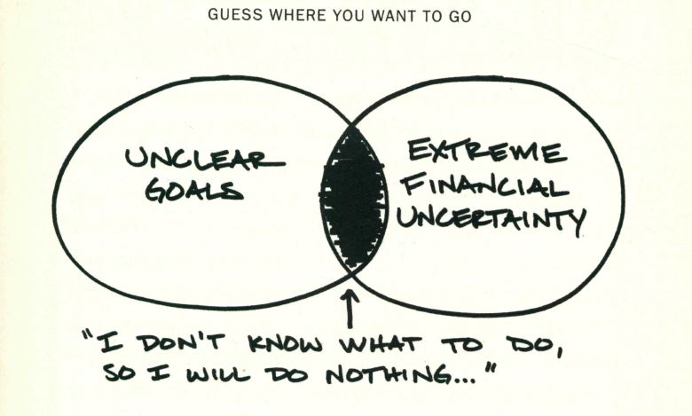
Budgets start the conversation
- from The One-Page Financial Plan by Carl Richards
Notes:
Budgets allow you:
To set goals
To control personal change, we dread knowing “stuff will happen”, and knowing what our resources are, who we are, allow us to better meet “stuff”
Examining how you spend every dollar let’s you see if your personal goals match up with your spending goals.
No judgement – everyone’s budget will be different, so if you like to eat out with your family, your budget will reflect that.
Starvation diets don’t work in the long run. Starvation budgets won’t either.

Slide 7
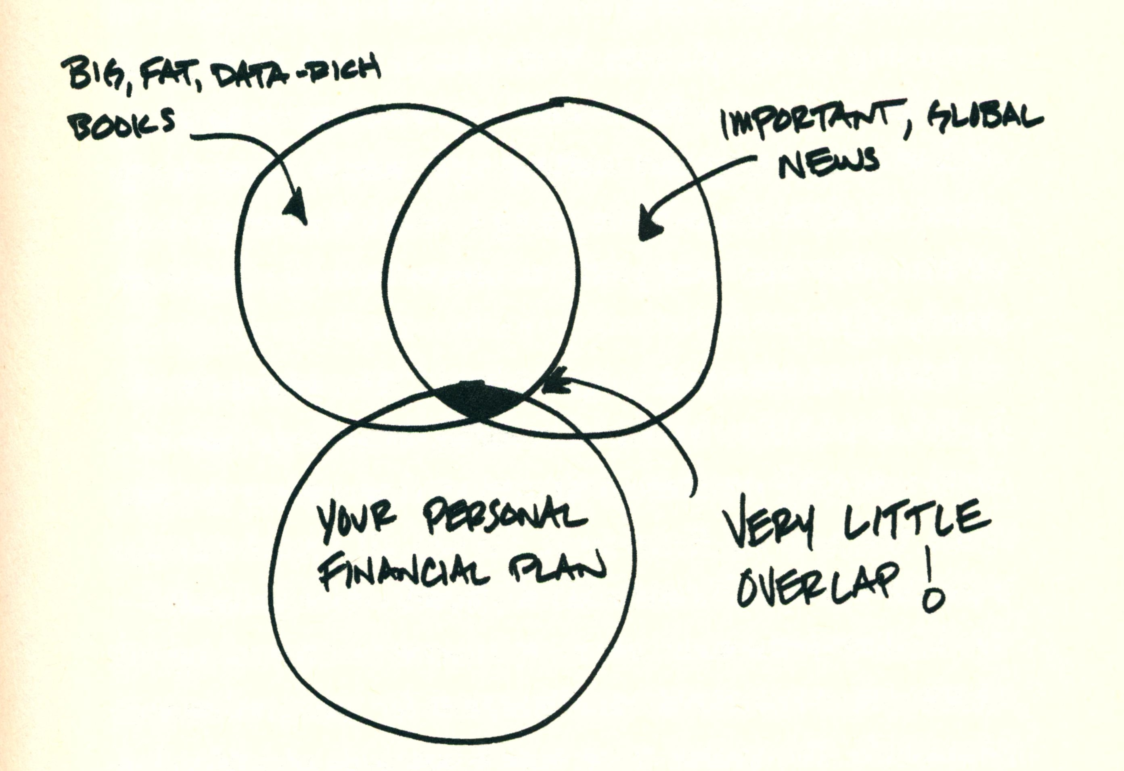
Budgets keep the conversation going
- from The One-Page Financial Plan by Carl Richards
Notes:
Sometimes, I get “Analysis Paralysis” with too much advice.
I listen to the nightly news, hear about world events that effect the economy.
Apple announces lower phone sales? Interesting, doesn’t effect me.
A new government scandal of the day? Interesting, doesn’t effect my budget.
State of Illinois’s budget is destroying college aid? Important, but my family can deal with it.
People remind me about Bernie Madoff and how he stole millions of dollars from his clients.
I see some of the Finance materials and get overwhelmed. I didn't study quantum math.
The Index Card book advocates “financial surfing” through the bad times – be prepared and just go with it, as opposed to freaking out.

Slide 8
Four general types of budgets we’ll discuss today:
Asset and Liability statement
Goal Budget
Envelope Budget
Zero Sum Budget

Slide 9
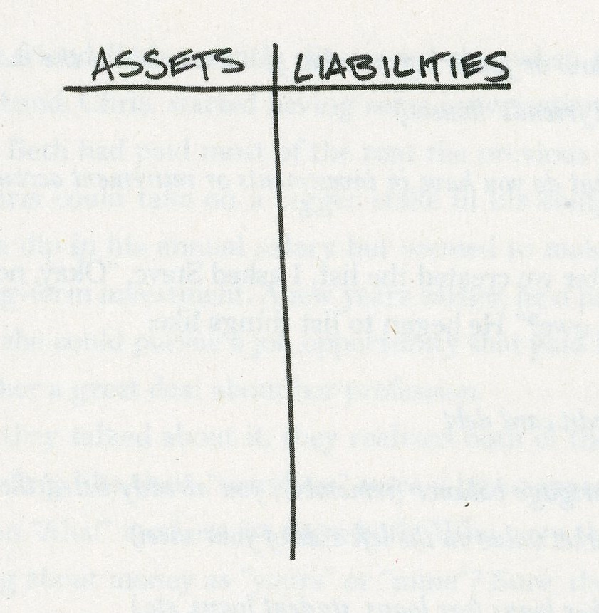
Assets – Liabilities = Net Worth
All the stuff you “own” goes in the left column, all the stuff you “owe” in the right hand column. Sum them up
- from The One-Page Financial Plan by Carl Richards
Notes:
Excel is great for creating a Net Worth sheet.

Slide 10
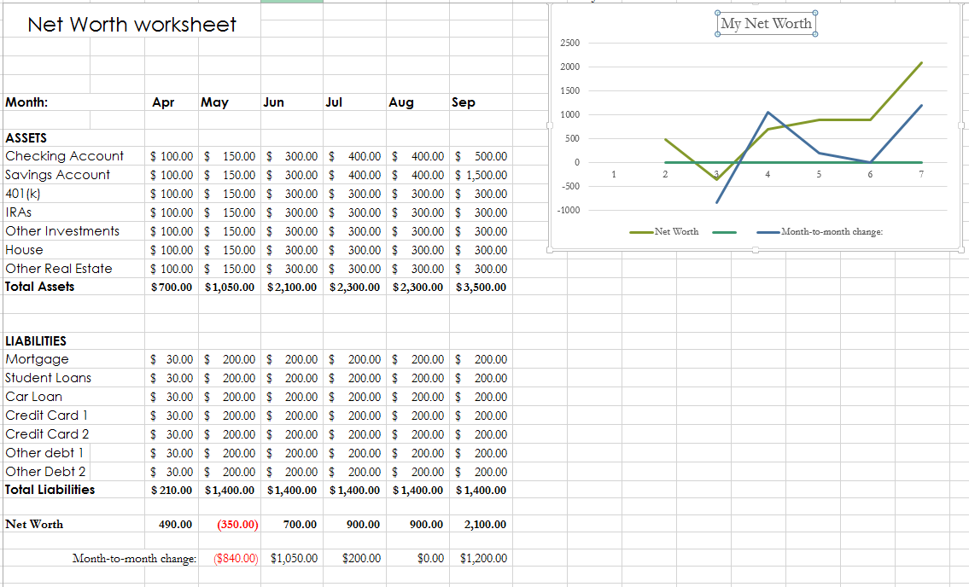
21232001024870
Snapshot of the last 6 months of net worth.
Go to Exercise #1

Slide 11
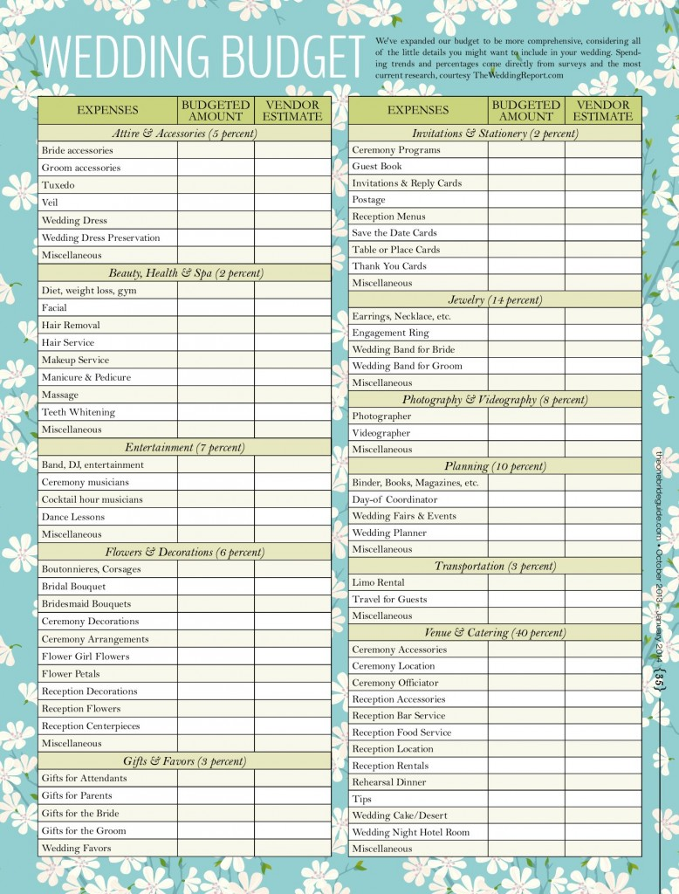
There are many sample budgets on Pinterest – both analog and digital.
Data from TheWeddingReport.com

Slide 12
Setting tangible and realistic goals, following them, and tracking your progress is the key to success in achieving all of your financial goals.
Let’s make a budget for a wedding!
Go to Exercise #2 in the handout

Slide 13
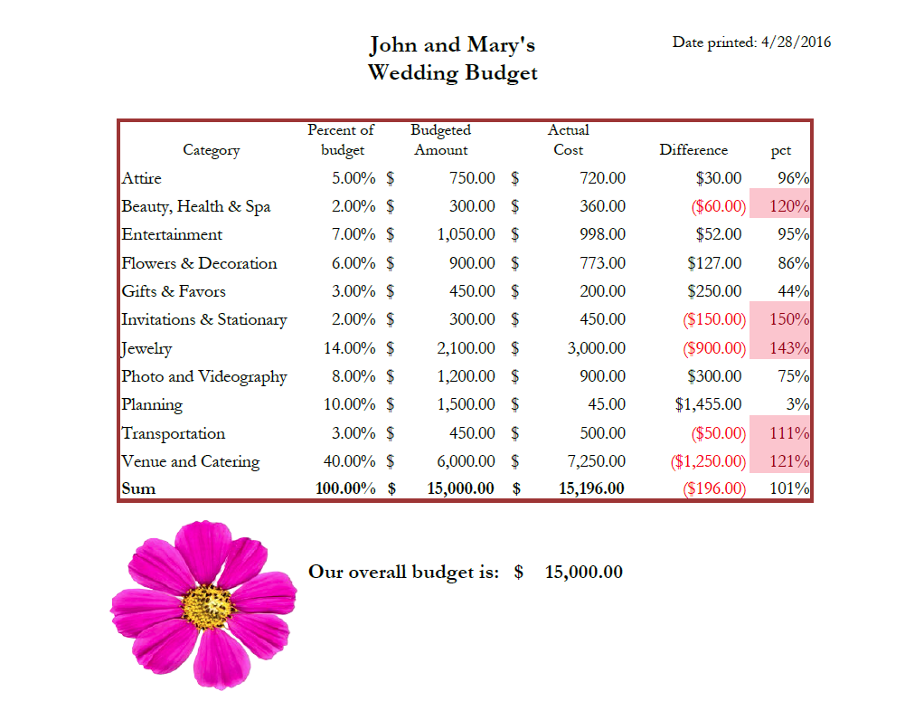
Components of a good Excel report:
Header: title and (printed on) date.
Page number optional.
Number are formatted and sum properly
Conditional formatting brings reader’s attention to potential problems.
Headers are centered over columns
Easy to maintain – uses Names and helper column.
Notes:
There were 31,587 weddings in Cook County in 2015.
The average wedding cost $29,838.00
Wedding dresses avg $1,211
Bar: $2,366
Food $4,747

Slide 14
Envelope Budget
Each time you get paid, fill envelopes with the amount of cash you have budgeted for specific spending categories until the next time you’re paid.
For example, if you get paid once a month and have a $400 monthly grocery budget, each time you get paid put $400 in cash into an envelope marked “Groceries.” When you go grocery shopping, take that envelope with you, pay for your groceries with the money in the envelope, and put the change back in the envelope.
Notes:
Each time you get paid, fill envelopes with the amount of cash you have budgeted for specific spending categories until the next time you’re paid.
For example, if you get paid once a month and have a $400 monthly grocery budget, each time you get paid put $400 in cash into an envelope marked “Groceries.” When you go grocery shopping, take that envelope with you, pay for your groceries with the money in the envelope, and put the change back in the envelope.

Slide 15
Zero Sum Budget
With a zero sum budget you tell your money where to go at the beginning of each month. You divvy up all your income between expenses, investments, and savings until you’re left with a $0.
Source: You Need a Budget www.youneedabudget.com

Slide 16
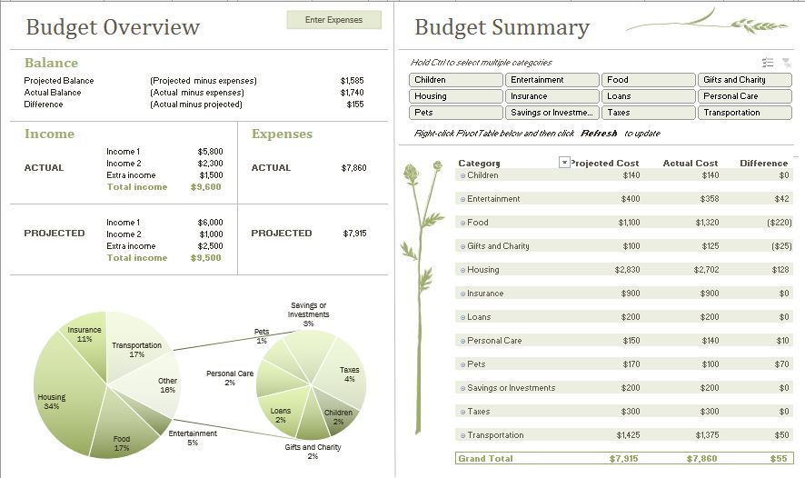
Family Budget (monthly) - MS Excel Template

Slide 17
Math
Simple functions
How to make a budget
Calculate Net Worth
Get married
Make a family budget
How to display a budget
Conditional formatting to highlight problems.
Sample templates
Best practices when making reports

Slide 18
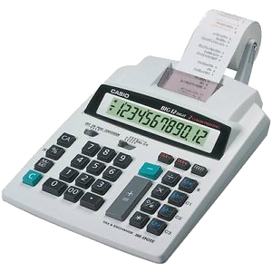
Excel is awesome with math
Balance your checkbook
Do complex math with a few clicks.
Do “What-if” scenarios

Slide 19
Making a budget with Excel uses a little math for most things:
SUM
ROUND
percentages
Arithmetic such as multiplication and division.
Let’s look at how Excel handles math
Go to page 1 in the handout.

Slide 20
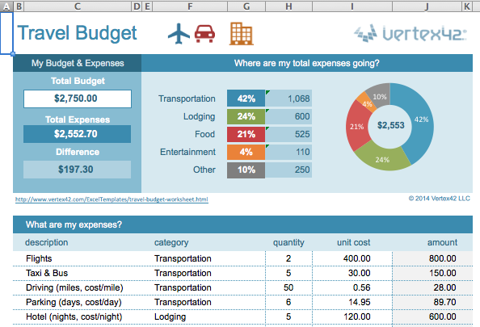
Excel is great with budgeting
Plan what you can spend on a project.
Make adjustments along the way.

Slide 21
Think of budgeting as surfing a financial wave.
- from The Index Card by Helaine Olen and Harold Pollack
Notes:
But while certain expenses can be planned and occur as regularly as waves – think of your rent or mortgage, for example – others cannot. As a result, the size and shape of this financial wave changes somewhat from month to month. One way to handle this? Know your regular and large expenses, monitor your other spending, and adjust as needed.
- Page 28, The Index Card, by Helaine Olen and Harold Pollack.

Slide 22
Look at known expenses
Guess about future expenses, Make future saving goals
Adjust as necessary

Slide 23
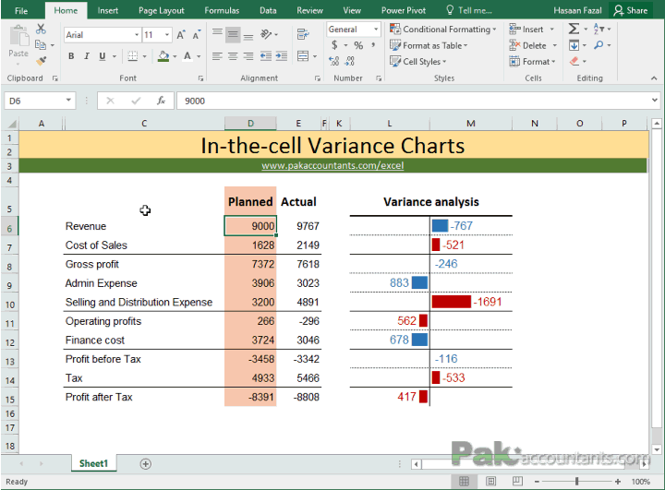
Excel makes useful presentations
Identify categories that go under or over budget

Slide 24
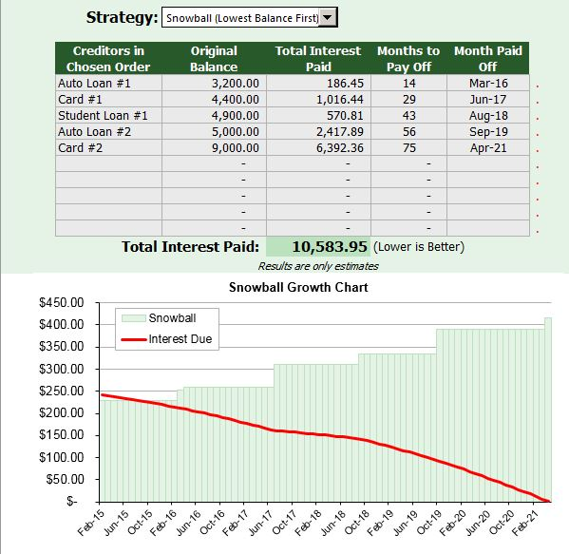
Snowball or Avalanche? Dave Ramsey encourages snowball. Pay the smallest debt of first. Template from Vertex42.com
Notes:
Dave Ramsey says snowball the best way because it helps you build up momentum by paying off the accounts with lowest balances first. You get quick wins by paying off accounts, and this makes you more likely to stick with your plan. After all, saving money is great, but it’s not gonna happen if you can’t stick with a plan long-term.

Slide 25
Excel gives you control over loans and investments.
Choose the best loan.
Evaluate different investment fees and rates.
Photo by “I saw the sign” on Flickr

Slide 26
Look at known expenses, gather info with family
Guess about future expenses, Make future saving goals
with family
Adjust as necessary with family

Slide 27
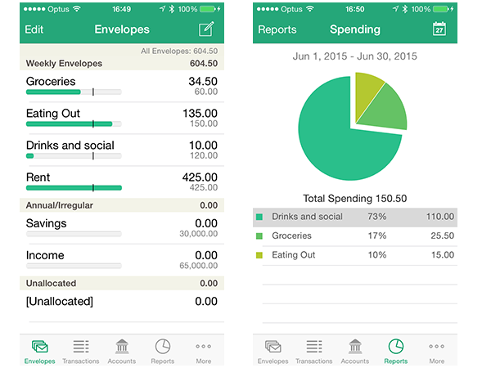
Ways to get everyone involved
Free phone apps to help track spending and even make budgets.
Notes:
This is “Track My Spending” by the Australian Securities and Investments Center. It creates a CSV record each time you add a new spending record.
Then when you want, you email that record to yourself, and upload it to a “Data” type sheet in Excel.
Multiple people can contribute.

Slide 28
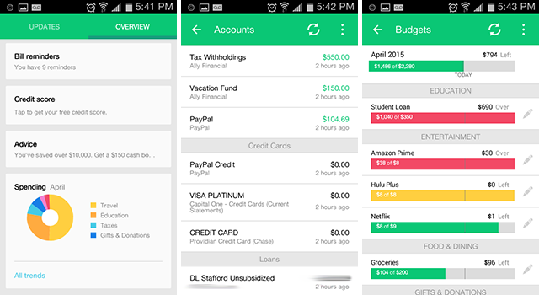
Mint.com, by Inuit. Free. All platforms.
Pulls in all your financial accounts – banking, investing, charge cards, etc.
Tracks and categorizes spending.
Notes:
Mint is an app that automatically pulls data from your banks, your loans, your credit cards, etc. and aggregates all of that information in one convenient location.

Slide 29
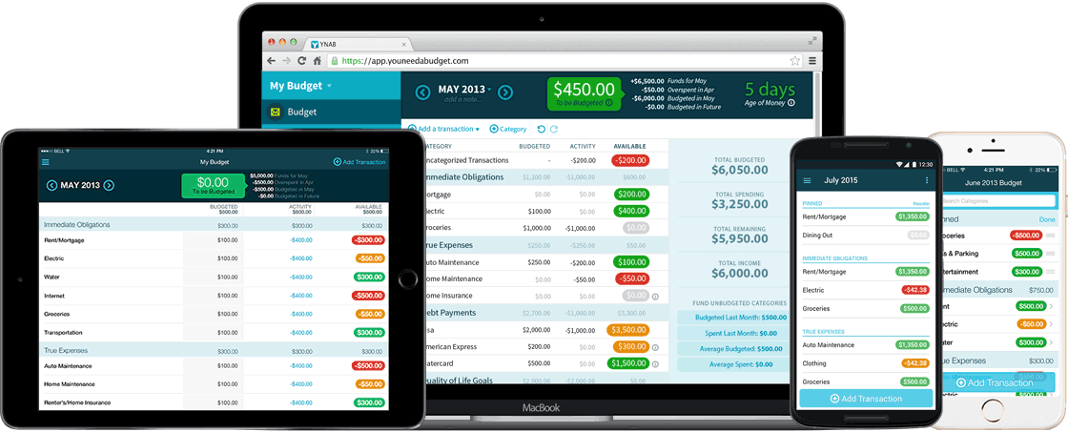
You Need a Budget (YNAB.com)
Evaluate for a month, $45 a year afterwards.
Very popular software, for all platforms
Notes:
Categorizes spending.
Create “envelopes” for saving.

Slide 30
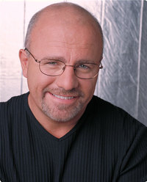
“If you will live like no one else, later you can live like no one else.”
- Dave Ramsey

Slide 31
More Excel classes:
Beginning Excel
Charts and Graphs
Formulas and Functions

Slide 32
Thank You
Want a copy of this presentation?
Visit www.skokielibrary.info/handouts
where this presentation will be available
for four weeks.

